Slide 1
Our Compassion Plan to Increase Resiliency and Hope
Quil Ceda Tulalip Elementary Marysville, Washington

Slide 2
Quil Ceda Tulalip Elementary
77% Free and Reduced Lunch
13% in Foster Care (according to OSPI)
50 students live with a grandparent
30 students have experienced a significant death (parent or sibling)
9 receiving McKinney-Vento
86 used Operation School Bell this year for clothes
75 receive Food for Thought from the local food bank every week

Slide 3
Vision
We value and respect all cultures and academics.
We value a growth mindset for adults and children.
We meet students where they are and work to accelerate their growth and learning.
We maintain compassion and high expectations.
We collaborate with staff, students and families.

Slide 4
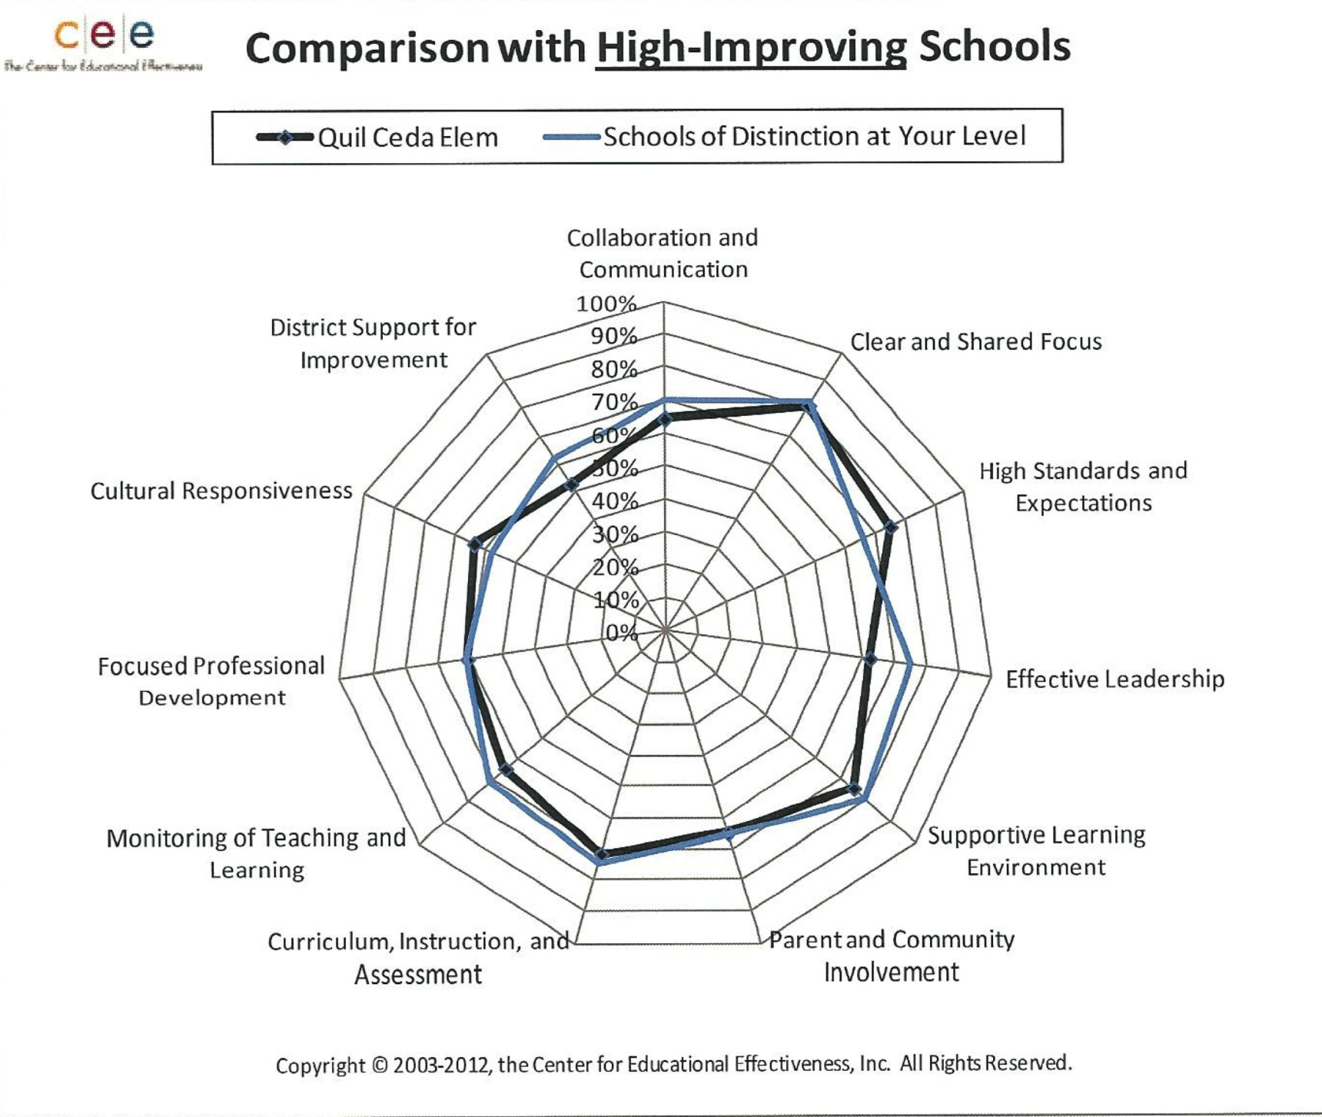

Slide 5
What we know…
Students in our school--100%--are EXCELLENT learners.
We need a learning environment that meets needs of students:
Cultural
Academic
Social/Emotional wellbeing
Through our work we are closing academic gaps in an accelerated way…

Slide 6
How do we teach S/E well-being?
Our Compassion Plan
Growth Mindset
Quil Ceda Tulalip’s Guidelines for Success
Morning message at daily assembly
PBIS –teach appropriate school behaviors and common area expectations
Common understanding that students do well if they are able (Ross Greene’s CPS model)
School-wide classroom lessons taught by school counselors
Adjust school-wide lessons based on data
Design grade-level and small group interventions based in data

Slide 7
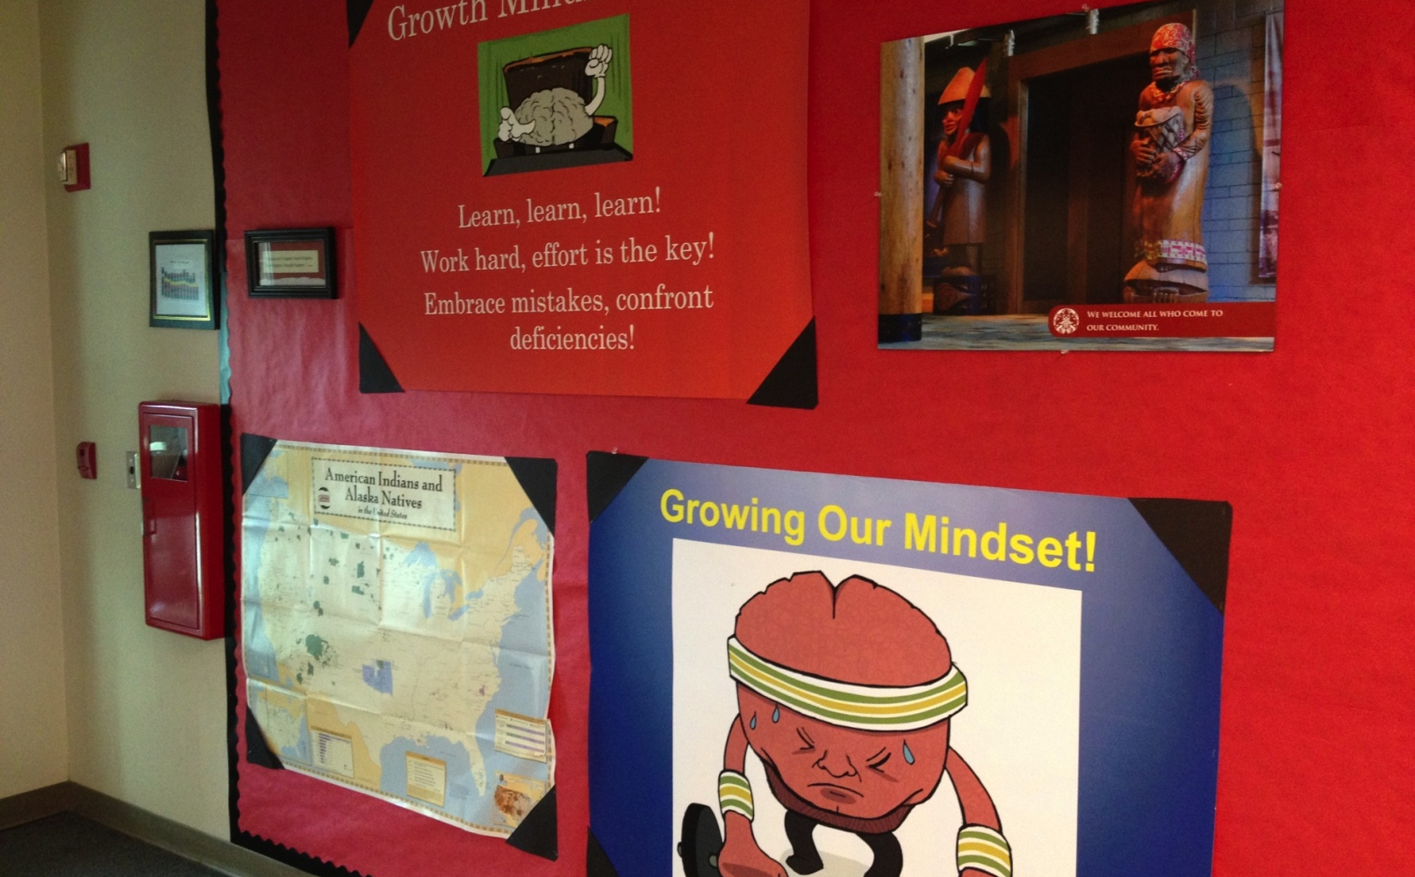
Growth Mindset

Slide 8
Guidelines for Success

Slide 9
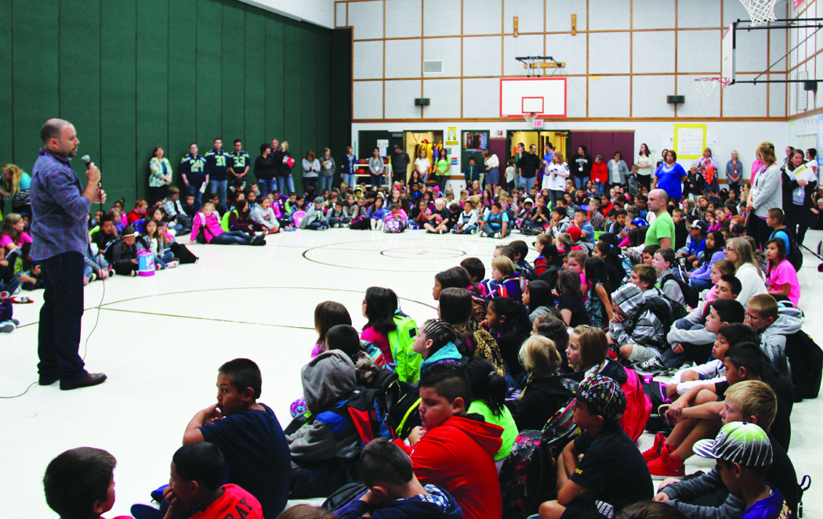
Morning Message

Slide 10
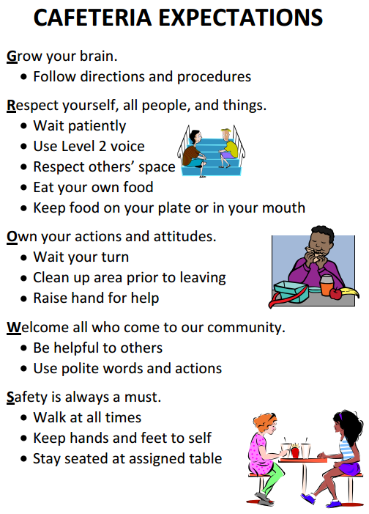
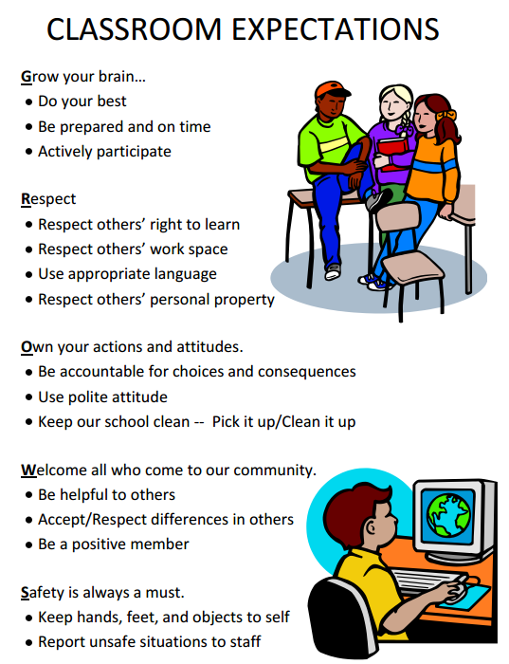
PBIS

Slide 11
Consequences of Trauma
Can affect learning and brain development
Relationships/attachment
Behavior
Self-regulation
Can manifest in many ways

Slide 12
Students who don’t perceive safety (over-perceive danger)
Inability to focus
Withdrawn
Clingy/Needy
Misinterpret events
Aggressive
Avoid

Slide 13
You might try:
Posting schedules
Warn of changes
Connect with student each day in the same way
Small connection rituals
Whole class motions
Keep your mood stable

Slide 14
Students who are not able to self-regulate well (physically/emotionally)
You might see:
Over-reacting
Tantrums
Mood swings
Trouble with transitions
Teasing/bullying
Spacing out
You might try:
Teach self-regulation tools
Teach emotional vocabulary
Whole class motion
Give student control when possible

Slide 15
Students who don’t succeed academically or socially
You might see:
Lots of excuses
Disruptive
Inability to focus
Not working well alone or in group
Low organizational skills
You might try:
Help student notice successes
Post schedule and homework
Use written and verbal instructions
Problem solve with student
Listen deeply
Ask, “What is your plan?”

Slide 16
Students who don’t believe they matter
You might see:
Giving up
Acting out
Appear anxious
Clingy/Needy
Aggressive
Avoidant
You might try:
Appreciation circles
Honest post-it notes
Get to know family
Notice strengths
Teach the class encouragement skills

Slide 17

Hope= Compassionate Schools
Create attachments
Learn to regulate self and behavior
Achieve confidence from gain in competencies
We are the First Responders

Slide 18

Breathing Strategy Demo
Hoberman Sphere
Square Breathing
Rocket-Ship Breath

Slide 19
Tulalip and Quil Ceda Elementary
Our Compassion Plan

Slide 20
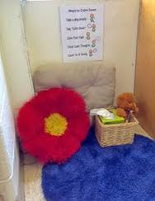
Always empower, never disempower
Check in and ask to silently make improvements
Give choices when possible
Solutions instead of consequences
Call home after problem fixed
Let student teach you and class something
Ask, “What is your plan?”
Have confidence in their ability to handle stress (Calm Zone option)

Slide 21

Unconditional Positive Regard
Be Kind and Firm
Connect with student each day
Small connection rituals (high five, etc.)
Teach encouragement skills
Appreciation circles
2X10 rule (2 encouragements/10 days)
Write honest post-its
Continue to acknowledge even when no longer in class
Share appreciations in private or post-it note
Listen deeply

Slide 22
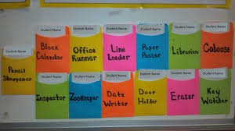
High Expectations
Not allow bullying or name-calling
Help set achievable goals + follow-up
Help student notice successes
“What is your plan?”
Classroom jobs
Notice and increase time spent mustering energy to persist on task even when challenging, effortful, or tedious

Slide 23
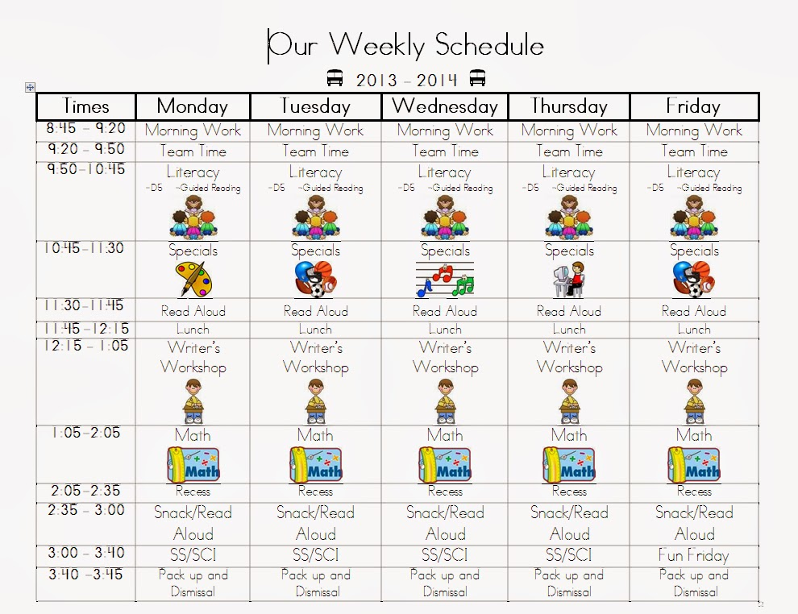
Check Assumptions/Be Proactive
Teach routines
Practice transitions
Warn of “surprises”
Know more about family, culture, and history at school
Accessible homework and schedule
Use written and verbal instructions
Learn about their life
Post schedules:

Slide 24
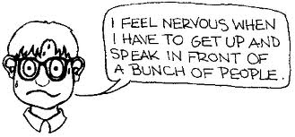
Be a Relationship Coach
Keep own mood stable
Teach emotional awareness
Teach self-regulation tools regularly
Teach encouragement skills
Say hello + name
Teach to make amends
Teach the “Calm Zone”
Teach a “sense of time”
Question inaccurate thoughts
Social Thinking– understand how others perceive my behavior
Super Flex
Peer mediation
Teach “I statements”
Teach handling transitions

Slide 25
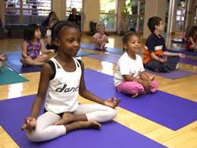
Guided Opportunities for Helpful Participation
Progressive muscle relaxation
Practice skills during play
Mindfulness
Tapping
Plan B (Ross Greene’s Collaborative Problem Solving)
Morning meetings
Appreciation circles
Class meetings
Yoga
Brain Gym
Opportunities to contribute in meaningful ways: classroom & school jobs

Slide 26
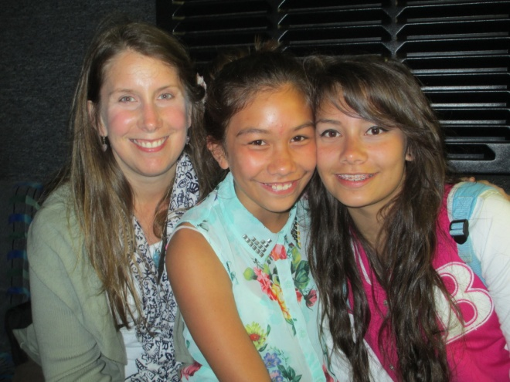
Through these Strategies, we establish:
Safety, connection, and trust
Improved emotional/behavioral self-regulation
Increased competence in: Academic Skills; Social Skills; and Personal Agency

Slide 27
Self-Care—An Ethical Obligation for Those Who Care
Love Yourself
Notes:
http://www.youtube.com/watch?v=IAQJ2yqfQME

Slide 28
Data, data, data. What can we use?
SWIS (office referrals and suspensions)
Students surveys
The Strengths and Difficulties Questionnaire (SDQ) sdqinfo.org
Anecdotal data from staff
Staff survey (ProQOL R-IV)
Notes:
With all of these strategies we needed a way to determine their effectiveness.

Slide 29
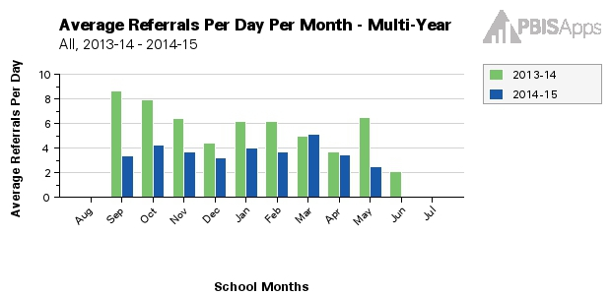
SWIS

Slide 30
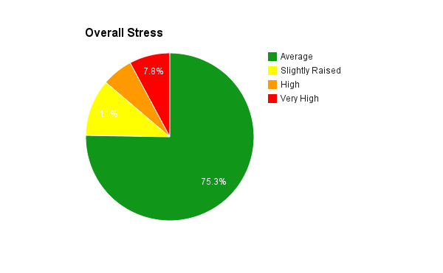
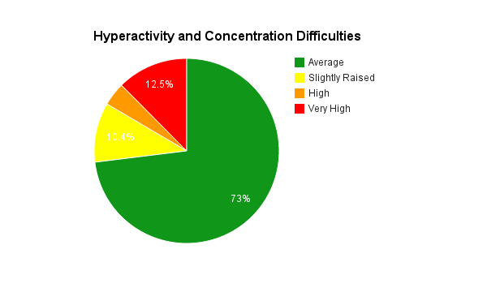
SDQ data for Fall
Notes:
Overall stress, emotional distress, behavior difficulties, hyperactivity and concentration difficulties, difficulty getting along with other children, kind and helpful behavior, impact of any difficulties on the child’s life.
We will give it once more this year and three times next year.

Slide 31
How we used the SDQ results:
Reviewed school-wide data with administrators and counselors to discuss needed changes or additions to PBIS lessons, morning message and counselor lessons.
Reviewed the school-wide and grade level data at grade level data teams.
Teachers reviewed their classroom data and determine area of greatest need for students.
Asked teachers to view their data through the lens of what skills need to be taught.
Used a modified problem solving cycle from Response to Intervention and Continuous School Improvement by Berhardt and Hebert (2011).

Slide 32
Our problem solving/data cycle:
Choose an area for improvement.
Choose a strategy/intervention.
What will it look like when it is implemented?
How will you know when it is working?
How will you measure the effectiveness of the intervention/what data will you keep?
Set end of cycle check-in to review data and effectiveness of the intervention.

Slide 33
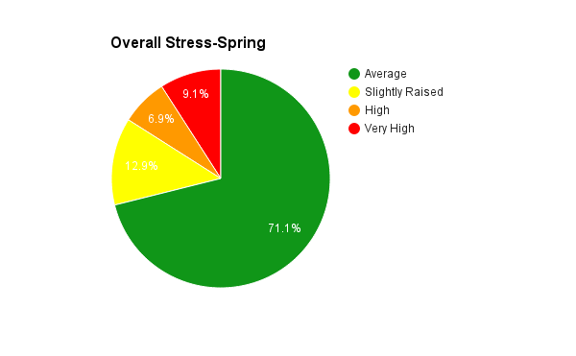
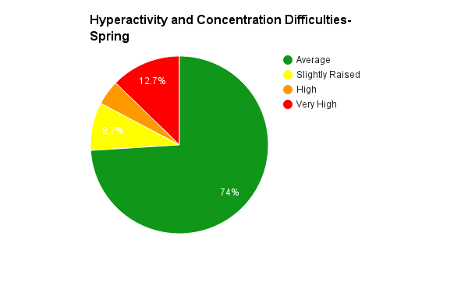
SDQ data for Spring

Slide 34
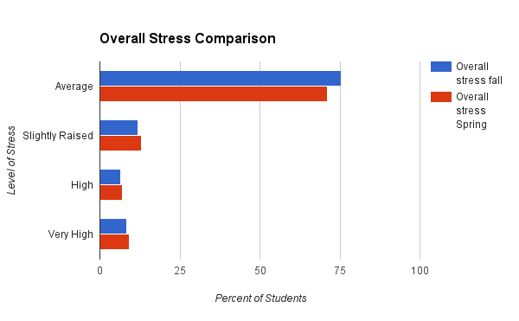
SDQ Comparison

Slide 35
Resources
Caring School Community curriculum by Developmental Studies Center www.devstu.org
The Heart of Learning and Teaching: Compassion, Resiliency, and Academic Success by Ray Wolpow, Mona M. Johnson, Ron Hertel and Susan O. Kincaid http://www.k12.wa.us/CompassionateSchools/HeartofLearning.aspx
Helping Traumatized Children Learn (purple book) www.massadvocates.org
Lost at School: Why Our Kids with Behavioral Challenges Are Falling Through the Cracks and How We Can Help Them by Ross W. Greene, Ph.D. livesinthebalance.org
Mindset: the New Psychology of Success; How we can Learn to Fulfill Our Potential by Carol S. Dweck, Ph.D.
Professional Quality of Life Scale (ProQOL R-IV) from Idaho State University http://proqol.org/ProQol_Test.html
Response to Intervention (RTI) and Continuous School Improvement (CSI): Using Data, Vision, and Leadership to Design, Implement, and Evaluate a School wide Prevention System by Victoria L. Bernhardt, and Connie L. Hébert

